Slide 1
Accumulators
accumulate information from prior recursive calls
three categories
preserve context from prior recursive calls
result so far
worklist
lecture 18 (previous)
this lecture

Slide 2
Roadmap
The next four lectures
forms of data: trees and graphs
recursion: structural non-tail and tail and generative
accumulators
path in data: previous, upper, lower, pnum, path, visited…
rsf (result so far)
path in tail recursion: visited, count, …
worklist
tandem worklist l18 l19 l20 l21

Slide 3
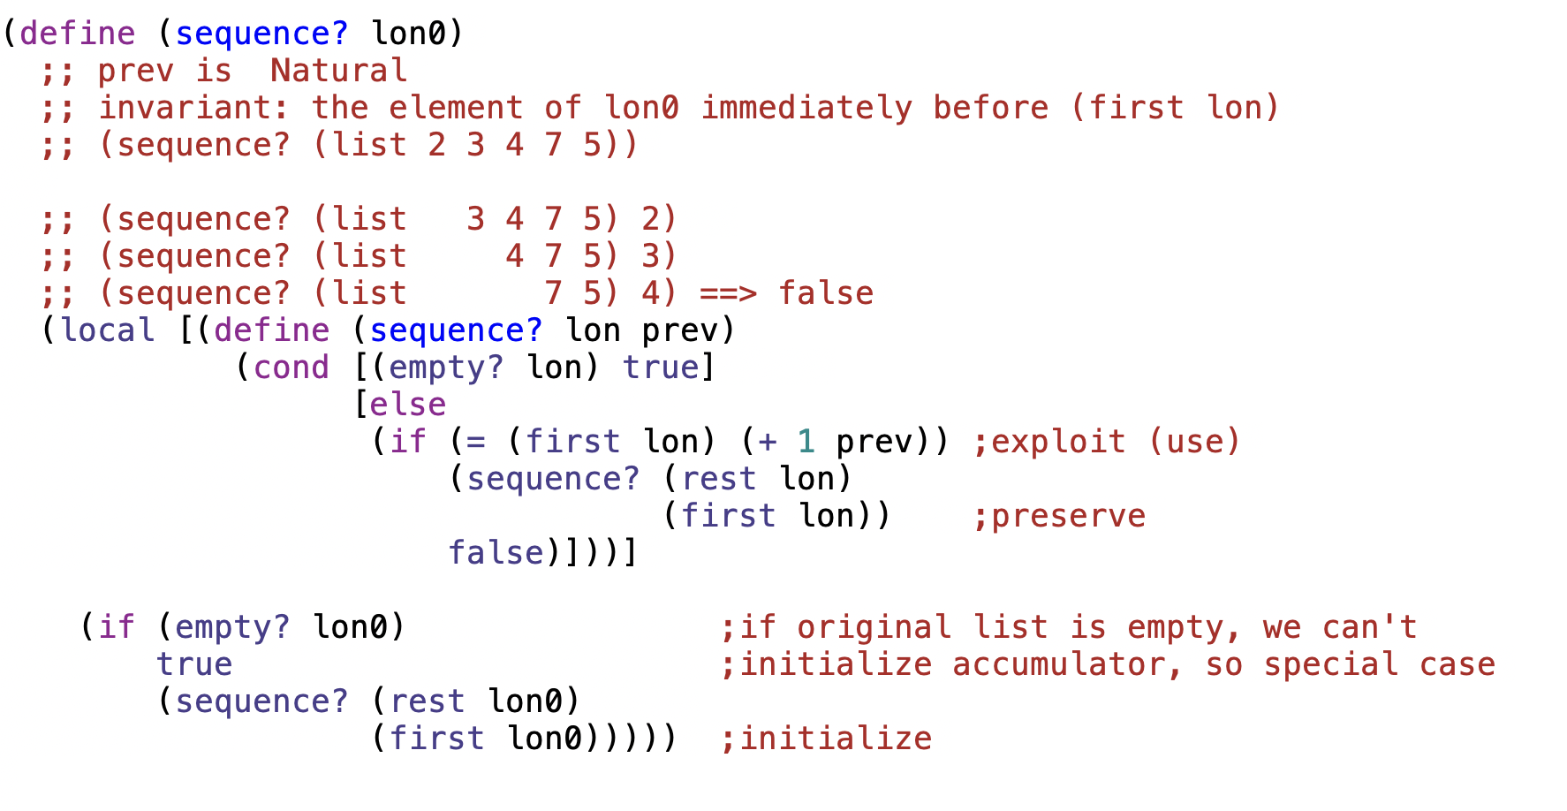

Slide 4
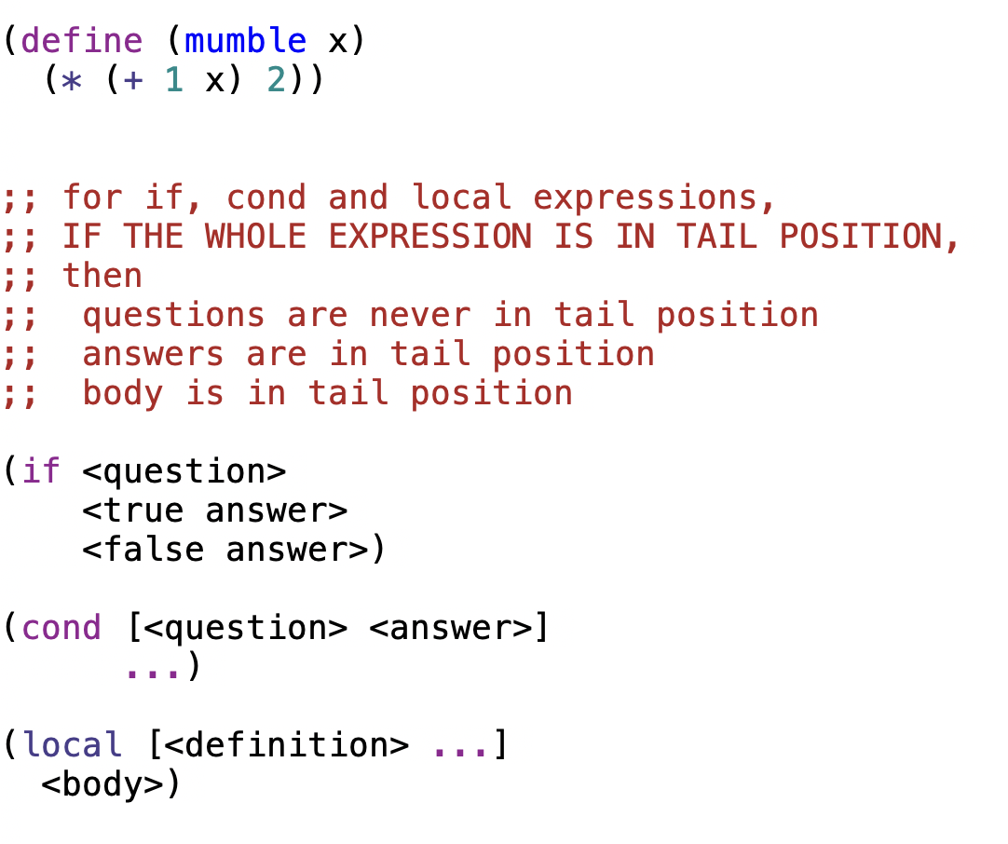
an expression is in tail-position when no surrounding expression in that function is waiting to operate on the value of the expression
tail position
not in tail position

Slide 5
definitions
an expression is in tail-position when no surrounding expression in that function is waiting to operate on the value of the expression
a function is tail-recursive when ALL recursive calls are in tail position
mutually-recursive functions are tail recursive when ALL recursive and mutually recursive calls are in tail position
in tail recursive functions, base cases produce the final result

Slide 6
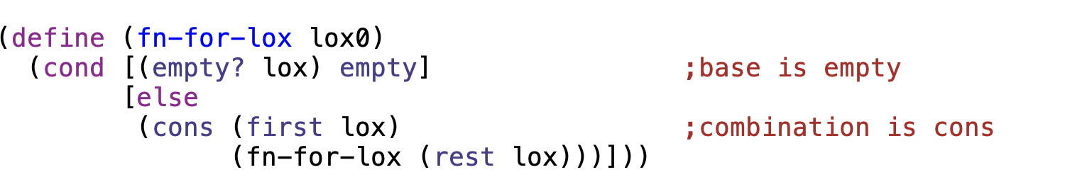
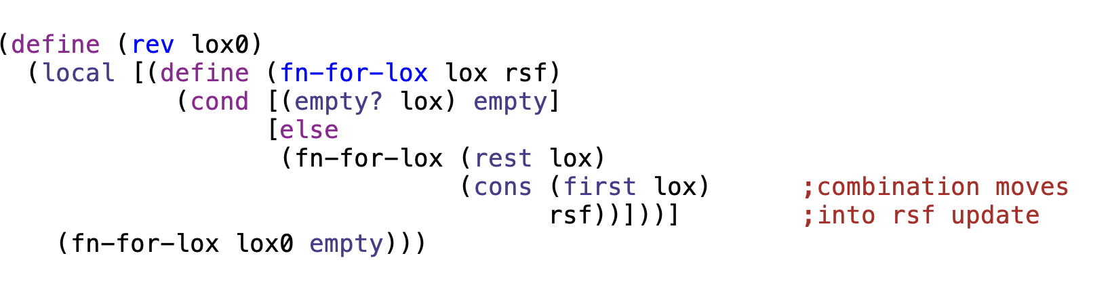
not in tail position
tail position

Slide 7
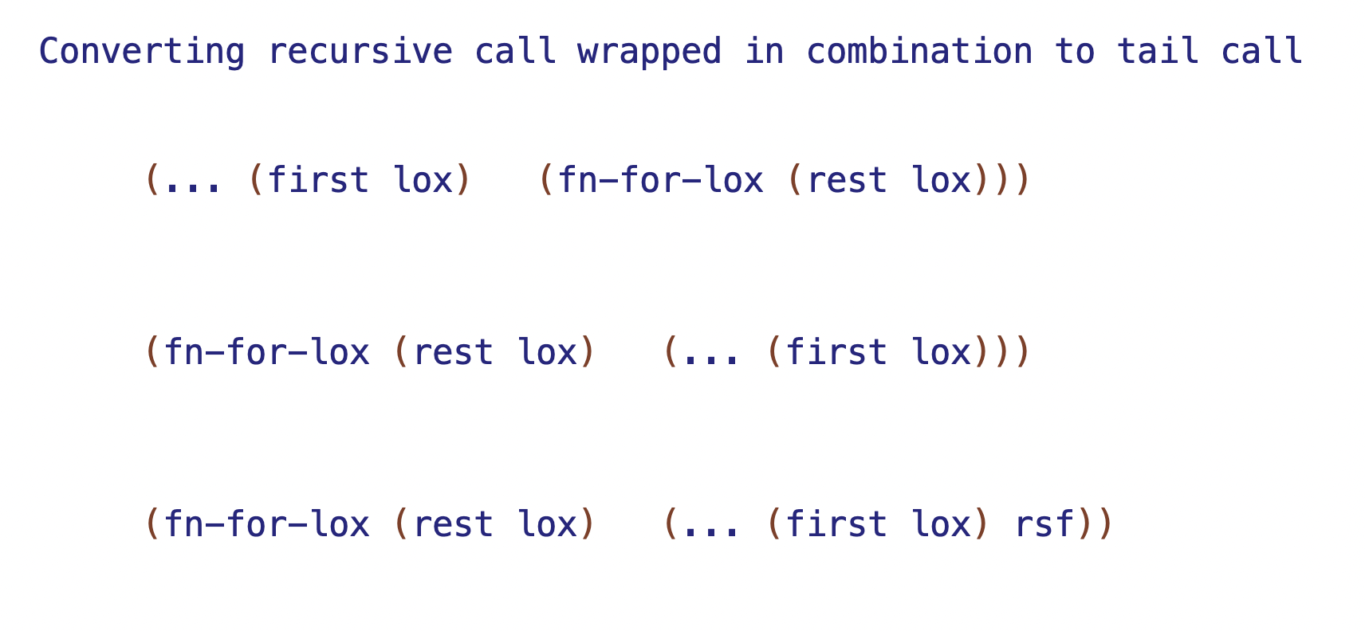

Slide 8
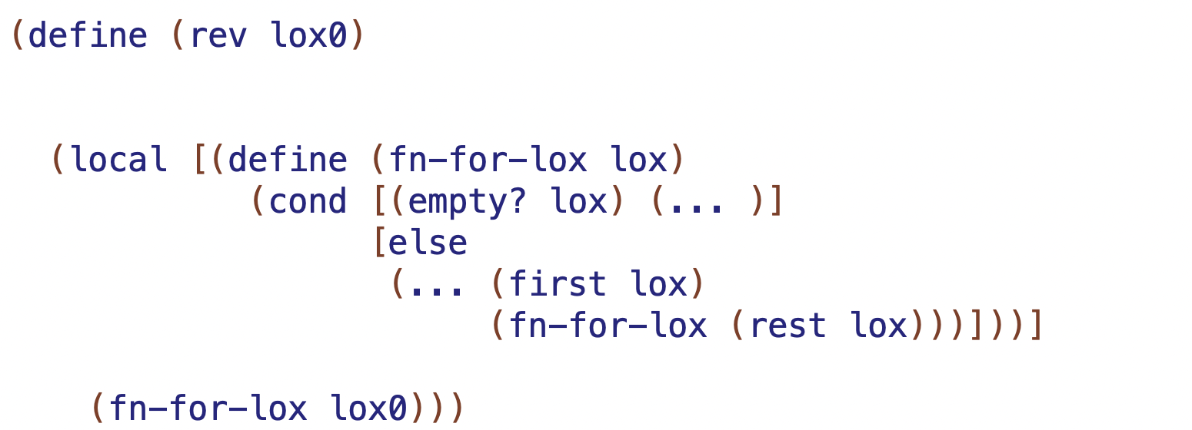
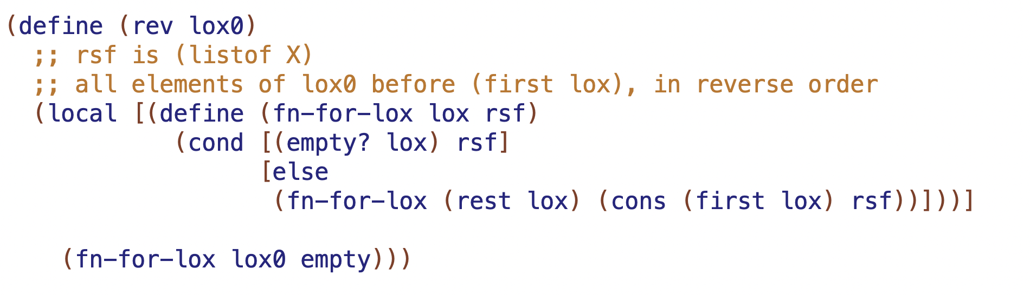
produce rsf at end
combination
initialize rsf (base case result)

Slide 9
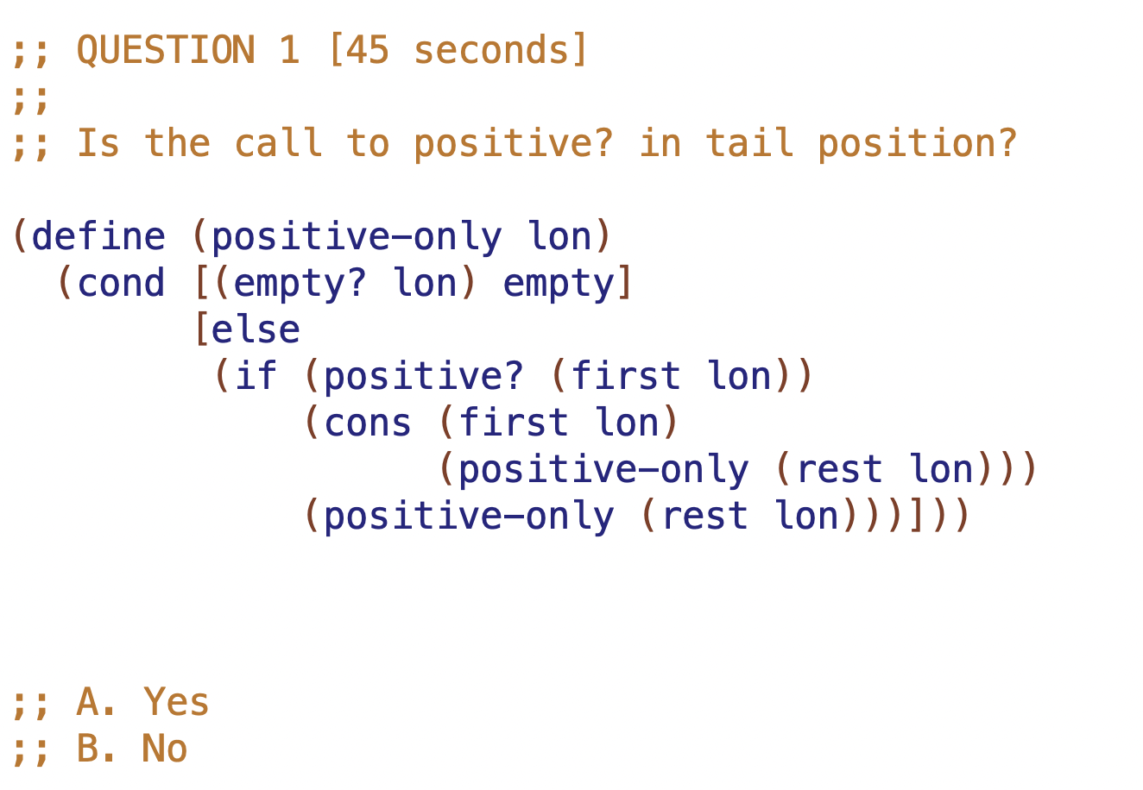

Slide 10
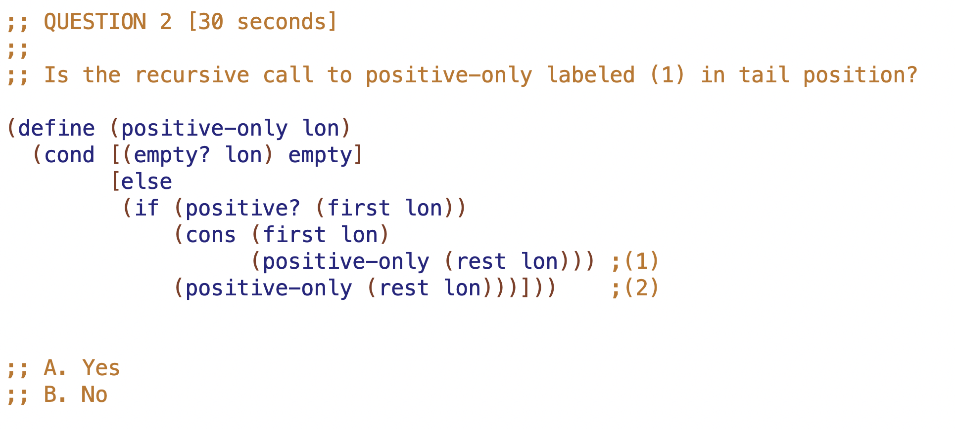

Slide 11
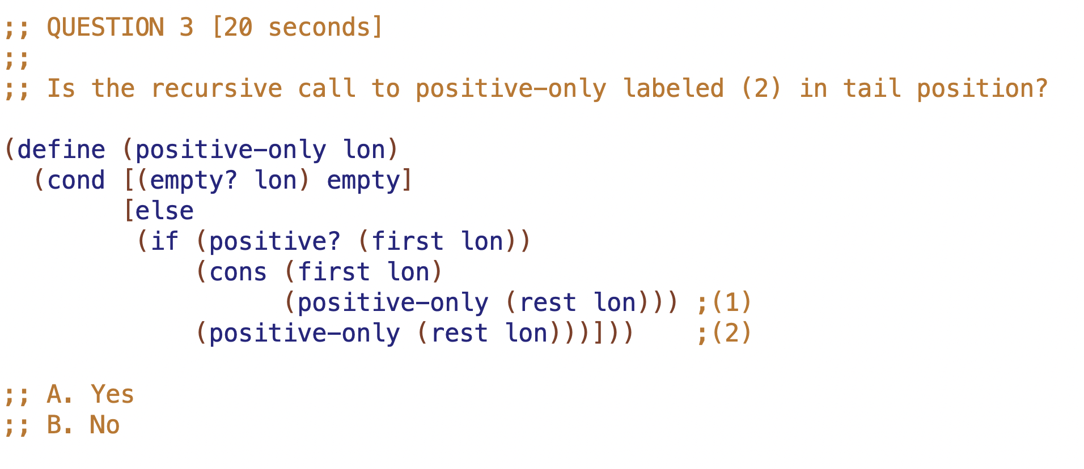

Slide 12
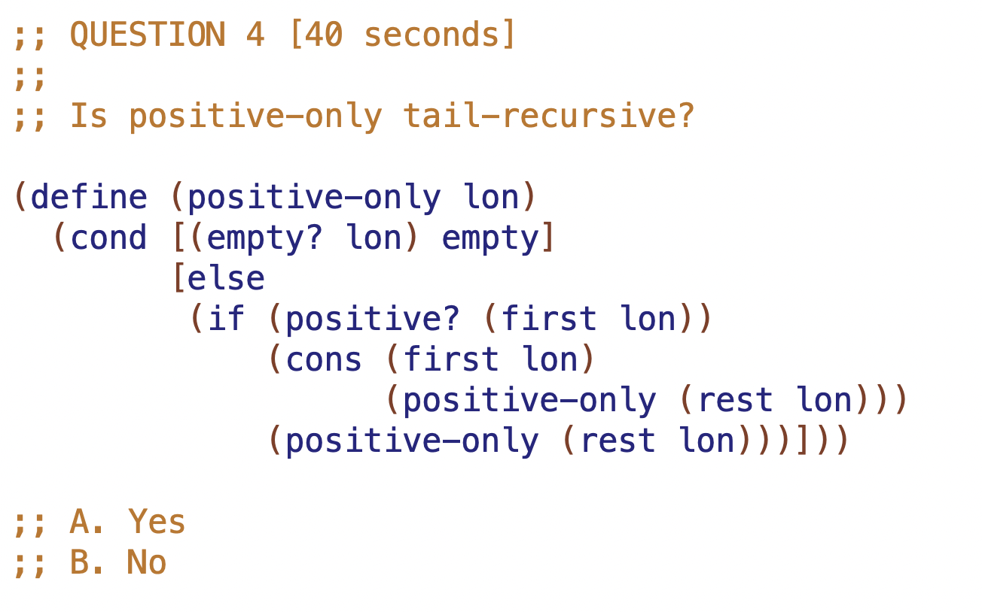

Slide 13
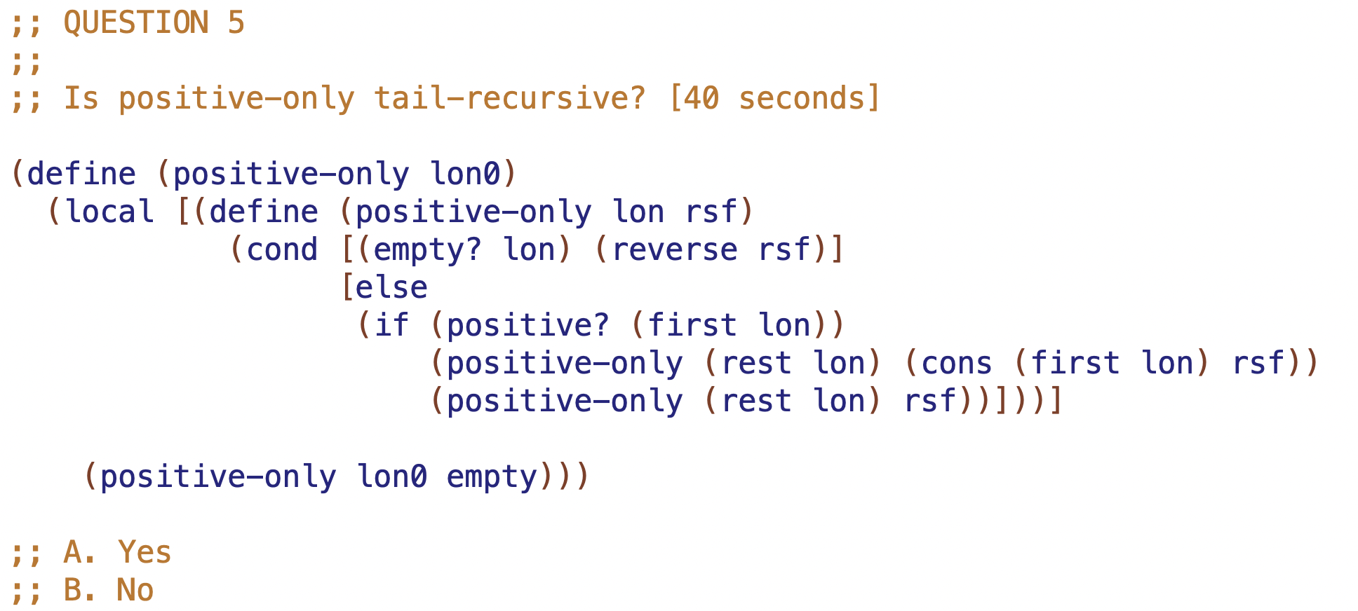

Slide 14
Example Tree
TOP1 - 10
M1 - 20
M2 - 40
L1 -30
L2 - 50
L3 - 60

Slide 15
TOP3 - 10
TOP1 - 10
TOP2 - 100
- 100
M1 - 20
M2 - 40
2 more Example Trees
L1 -30
L2 - 50
L3 - 60

Slide 16
NOTATION
fn-for-t is called with 1 tree
TOP1 - 10
fn-for-lot is called with list
M1 - 20
M2 - 40
L1 -30
L2 - 50
L3 - 60

Slide 17
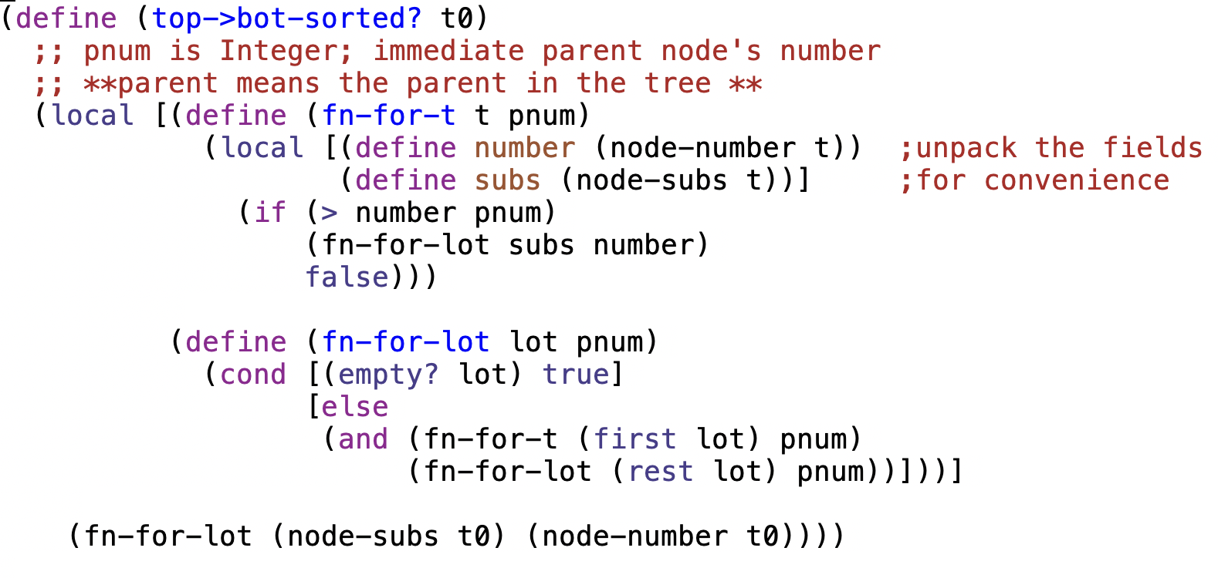

Slide 18
typical structural recursion
calls and results produced
TOP1 - 10
M1 - 20
M2 - 40
L1 -30
L2 - 50
L3 - 60
calls to fn-for-lot with empty

Slide 19
What’s in the past depends on the recursion
tail recursion means current call can have all the preceding context
→ it can produce answer directly
in a tree
ordinary recursion can carry context of what is above current call
but tail recursion is required to carry context of what is above and to the LEFT

Slide 20
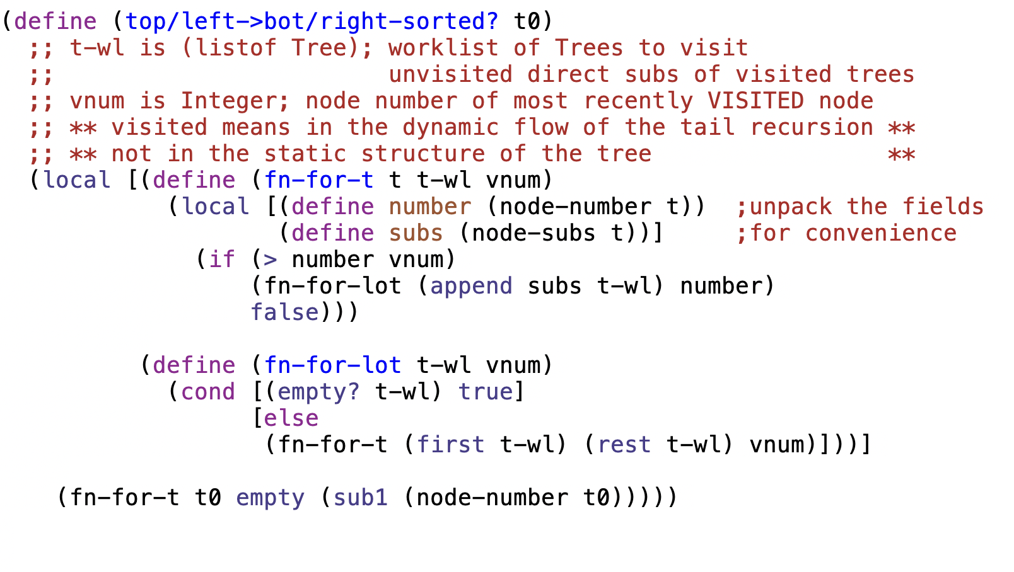

Slide 21
tail recursion with worklist
calls
tree worklist (tree-wl)
at fn-for-t and fn-for-lot
TOP1 - 10
M1 - 20
M2 - 40
L1 -30
L2 - 50
L3 - 60

Slide 22
l20

Slide 23
Overview
The next three lectures
forms of data: trees and graphs
recursion: structural and tail
accumulators
rsf (path)
path in data: path, depth…
path in tail recursion: visited, count…
worklist
tandem worklist l20

Slide 24
Accumulators – 2 goals, 3 kinds
Goal | Kind of invariant
Preserve context from prior recursive calls | Context preserving parent house in same house… Result so far rsf in sum, product Work list (for TR on tree or graph) upper left fringe of unvisited tree
Achieve tail recursion

Slide 25
structural recursion
(find-path TOP “L2”) must produce (list “TOP” “M2” “L2”)
So what SHOULD BE value of path at each call to fn-for-lot?
TOP
1
22
2
21
9
10
M1
M2
3
11
20
8
4
12
19
7
15
16
L1
L2
L3
5
6
13
14
17
18

Slide 26
path; names of parents to here
With path accumulator
showing path at each call to fn-for-lot
empty
TOP
(list "TOP")
M1
M2
(list "TOP" "M1")
(list "TOP" "M2")
L1
L2
L3
(list "TOP" "M1" "L1")
(list "TOP" "M2" "L2" )
(list "TOP" "M2" "L3" )

Slide 27
[3 minutes]
Given the tree to the right,and given a TAIL-RECURSIVE traversal of the tree, as in find-tree last time, consider the call to fn-for-t with a first argument of L2. What will be the value of
tree-wl at that call?
(fn-for-t L2 (list M3))
(fn-for-t L2 (list TOP M1 L1 M2))
(fn-for-t L2 (list L2 M3))
(fn-for-t L2 (list L3 M3))
(fn-for-t L2 (list L2 L3 M3))
TOP
M1
M2
M3
L1
L2
L3
worklist is unvisited direct subs of visited nodes

Slide 28
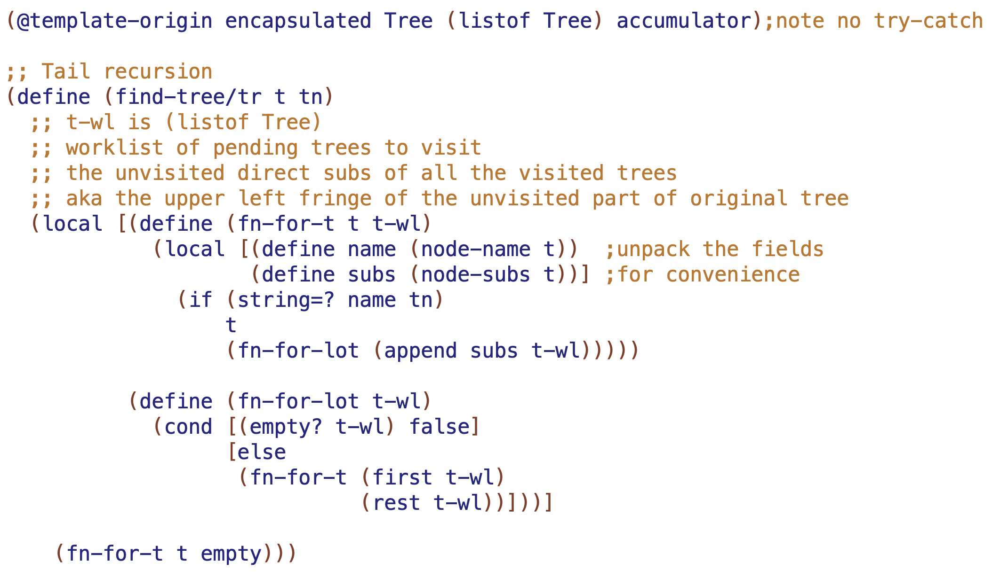

Slide 29
tail recursion with worklist
showing tree-wl at calls to fn-for-lot
tree worklist at fn-for-t and fn-for-lot
empty
TOP
1
(list M1 M2)
2
(list M2)
M1
M2
empty
3
7
(list L1 M2)
(list L2 L3)
4
8
6
(list M2)
(list L3)
empty
L1
L2
L3
5
9
10
11
(list M2)
(list L3)
empty

Slide 31
fill in ??? at calls to fn-for-t
can do fn-for-lot too if that helps
TOP
M1
M2
L1
L2
L3

Slide 32
fill in visited at calls to fn-for-t
()
TOP
("TOP" )
("TOP" )
M1
M2
("TOP” ”M1” ”L1" )
("TOP” ”M1" )
("TOP” ”M1” ”L1” “M2” )
("TOP” ”M1” ”L1" )
("TOP” ”M1" )
L1
L2
L3
("TOP” ”M1” ”L1” “M2” )
("TOP” ”M1” ”L1” “M2” “L2” “L3”)

Slide 33
fill in visited at calls to fn-for-t
()
TOP
("TOP" )
M1
("TOP" "M1" "L1")
M2
("TOP" "M1")
L2
L1
L3
("TOP" "M1" "L1" "M2")
("TOP" "M1" "L1" "M2" "L2")

Slide 34
TOP
…needs to have the path this call would have had
M1
M2
this call …
L1
L2
L3

Slide 35
TOP
("TOP")
…needs to have the path this call would have had
when we put M2 on the tree-wl,
we had a path of (“Top”)
("TOP")
("TOP" "M1" "L1")
M1
M2
this call …
L1
L2
L3

Slide 36
tail recursion with TANDEM WORKLISTS
each element of path worklist is the path for the corresponding element of the tree worklist
TOP
tree worklist:
(M1 M2)
1
path worklist:
(("TOP") ("TOP”))
2
M1
M2
(L1 M2)
3
(M2)
7
(L2 L3 )
((“TOP” “M1”) ("TOP”))
(("TOP”))
6
(("TOP” “M2”) ("TOP” “M2”))
4
8
5
( M2)
(("TOP”))
L1
L2
8
L3
(L3 )
9
(L3 )
(("TOP” “M2”))
(("TOP” “M2”))

Slide 37
arb arity tree structural recursion templates
TOP
(@template Tree (listof Tree) encapsulated)
(define (fn-for-tree t)
(local [(define (fn-for-t t)
(local [(define name (node-name t)) ;unpack the fields
(define subs (node-subs t))] ;for convenience
(... name (fn-for-lot subs))))
(define (fn-for-lot lot)
(cond [(empty? lot) (...)]
[else
(... (fn-for-t (first lot))
(fn-for-lot (rest lot)))]))]
(fn-for-t t)))
M1
M2
L1
L2
L3

Slide 38
find-path: structural recursion with path accumulator.
TOP
(@template Tree (listof Tree) accumulator)
(define (find-path t n)
;; path is (listof String); names of ... grandparent, parent trees
;; (builds along recursive calls)
(local [(define (fn-for-t t path)
(local [(define name (node-name t))
(define subs (node-subs t))
(define npath (append path (list name)))]
(if (string=? name n)
npath
(fn-for-lot subs npath))))
(define (fn-for-lot lot path)
(cond [(empty? lot) false]
[else
(local [(define try (fn-for-t (first lot) path))]
(if (not (false? try))
try
(fn-for-lot (rest lot) path)))]))]
(fn-for-t t empty)))
M1
M2
L1
L2
L3

Slide 39
find-tree: tail recursion with worklist
TOP
(@template backtracking Tree (listof Tree) accumulator)
(define (find-tree t to)
;; tree-wl is (listof Tree)
;; worklist of pending trees to visit
(local [(define (fn-for-t t tree-wl)
(local [(define name (node-name t)) ;unpack the fields
(define subs (node-subs t))] ;for convenience
(if (string=? name to)
t
(fn-for-lot (append subs tree-wl)))))
(define (fn-for-lot tree-wl)
(cond [(empty? tree-wl) false]
[else
(fn-for-t (first tree-wl)
(rest tree-wl))]))]
(fn-for-t t empty)))
M1
M2
L1
L2
L3

Slide 40
tail recursion with tandem worklists (tree and path), also visited
(@template Tree (listof Tree) accumulator)
(define (find-path t to)
;; tree-wl is (listof Tree)
;; worklist of trees to visit (unvisited subs of already visited trees)
;;
;; path-wl is (listof (listof String))
;; worklist of paths to corresponding trees in tree-wl
;;
;; visited is (listof String)
;; names of trees visited so far (builds along tail recursive calls)
(local [(define (fn-for-t t path tree-wl path-wl visited)
(local [(define name (node-name t))
(define subs (node-subs t))
(define npath (append path (list name)))
(define nvisited (append visited (list name)))]
(if (string=? name to)
npath
(fn-for-lot (append subs tree-wl)
(append (map (lambda (s) npath) subs) path-wl)
nvisited))))
(define (fn-for-lot tree-wl path-wl visited)
(cond [(empty? tree-wl) false]
[else
(fn-for-t (first tree-wl)
(first path-wl)
(rest tree-wl)
(rest path-wl)
visited)]))]
(fn-for-t t empty empty empty empty)))
TOP
M1
M2
L1
L2
L3

